Slide 1


BTEC Higher Nationals Computing and Systems Development
  Londontec City Campus
Data Analysis and Design
Introduction
  By K. Pradeep Manjula
Database-Introduction-1

Slide 2
Data and Database Systems
Data is one of the most important resources in ALL organisations. Without data it is not possible to operate.
    Control manufacturing processes?
    Process sales of goods?
    Diagnose patients’ illnesses?
    Forecast sales?
    Run the University of Teesside?
To be useful data must be processed into information. It must be:
    Accurate
    Timely
    Relevant
Therefore, you need adequate facilities for storing data and processing information:
  Storing (and verifying) data
  Manipulating data
  Extracting data
Database-Introduction-1

Slide 3
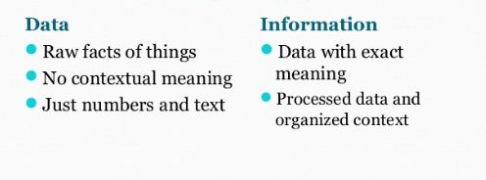
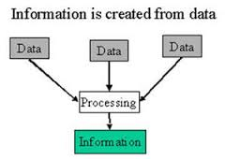
Data Vs Information
Database-Introduction-1

Slide 4
History of Database System
History
  50’s and 60’s all applications were custom built for particular needs
  File based
  Many similar/duplicative applications dealing with collections of business data
  Early DBMS were extensions of programming languages
  1970 - E.F. Codd and the Relational Model
  1979 - Ashton-Tate & first Microcomputer DBMS
Database-Introduction-1

Slide 5
File - based System
From the earliest days computers were used to store files of data.
Separate systems, ie separate files and programs, were developed for each application, eg stock files, production files, accounts files, etc.
Applications processed the data to provide information.
Data
Application
Department
Part No, Supplier, qty
location, reorder qty
Stock Control
Stores
Problems
Inconsistency
Redundancy
Lack of integration
Lack of control
Part#, qty, Assy#,
Machine#, Cert.#:
Production
Operations
Supplier, Part#, Part#, Cost, Qty
Accounts
Finance
Database-Introduction-1

Slide 6

File Based Systems
Application
File
Toys
Delivery
List
Addresses
Coal
Estimation
Naughty
Nice
Toys
Just what
asked for
Database-Introduction-1

Slide 7
From File Systems to Database Systems
Problems with File Processing systems
  Inconsistent Data
  Inflexibility
  Limited Data Sharing
  Poor enforcement of standards
  Excessive program maintenance
Database-Introduction-1

Slide 8
Databases
“A shared collection of logically related data, and a description of this data, designed to meet the information needs of an organisation.”
  ‘Database Systems’ by Connolly & Begg Addison-Wesley, ISBN 0-201-70857-4
“A database system can be thought of as a computerised record-keeping system. Such a system involves the data itself (stored in the database), hardware, software and – most important! – users.
… Databases are integrated and (usually) shared; they are used to store persistent data.”
  ‘An Introduction to Database Systems’ by C J Date, Addison-Wesley, ISBN 0-201-38590-2 (7th Edition, 2000)
Database-Introduction-1

Slide 9
DBMS
“A software system that enables users to define, create, maintain, and control access to the database.”
Provides the interface between the user and the data in the database.
Allocates storage to data and maintains indices so that any required data can be retrieved.
Protects data against unauthorised access.
Safeguards data against corruption.
Provides recovery and restart facilities after a hardware or software failure.
Database-Introduction-1

Slide 10
Database and DBMS
DBMS is the environment used to manage a database
The database consisting of stored data and processed information for a system
Data are organised into a single set of underlying TABLES from which the applications draw the data to provide information that are relevant to them.
Department
Application
Stock Control
Database
Database
Management
System
DBMS
Supplier, Supplier Pt No:, Part No:
Cost, Qty ordered, Qty del., qty, Assy No:,
Machine No:, Cert. No: location, reorder qty
Production
Accounts
Database-Introduction-1

Slide 11
Data Models
A Data Model provides a particular way of thinking about data, at least in terms of its structure
Data Models include data descriptions, data relationships, data semantics, consistency constraints [Silberschatz et. al.]
Data model comprises three components: data structures, data manipulators, and general integrity rules [Codd (1970)]
There are many types of data model.
  Hierarchic - Network - Relational - Multidimensional
  Entity-Relationship - Object-Oriented - Multimedia - etc.
Each database uses a definition language
  imposes restrictions on
    what can be defined
    how entities relate to each other
In this module we are interested mainly in the Relational and Entity-Relationship data models.
Why? The principles involved in Entity Relationship Modelling apply to all data models
Database Introduction-2

Slide 12
Data Model
Models
  (1) Levels or views of the Database
    Conceptual, logical, physical
  (2) DBMS types
    Relational, Hierarchic, Network, Object-Oriented, Object-Relational
Database-Introduction-1

Slide 13
Data Model
  Data Models produced early in Systems Development
  Makes improvements in terms of :
    NO DUPLICATION or REDUNDANT or NULL INFORMATION
    REDUCTION IN PHYSICAL SIZE
    QUICKER INFORMATION RETRIVAL
    LEADS TO A FULLY OPTIMISED SET OF TABLES
  Data Model produced by Case Tools techniques
    Normalisation
      Rule based technique for transferring logical datastore view to physical view
    Entity Relationship Modelling.
      Diagrammatic representation of a proposed systems database requirements
  Data Model provides
    a full set of related tables and data
    Able to derive physical views (internal schema) of data
    Able to derive logical views (external schema) of data
Database-Introduction-1

Slide 14
Database Types - 3 Main Data Models
Each database uses a definition language
  imposes restrictions on
    what can be defined
    how entities relate to each other
Hierarchical model
Network model
Relational model
Supplement 01 (a)
Database-Introduction-1

Slide 15
Models (1)
Application 1
Application 2
Application 3
Application 4
External
Model
External
Model
External
Model
External
Model
Application 1
Conceptual
requirements
Application 2
Conceptual
requirements
Conceptual
Model
Logical
Model
Internal Model
Application 3
Conceptual
requirements
Application 4
Conceptual
requirements
Database-Introduction-1

Slide 16
Data Models(2): History
Hierarchical Model (1960’s and 1970’s)
  Similar to data structures in programming languages.
Books
(id, title)
Authors
(first, last)
Publisher
Subjects
Database-Introduction-1

Slide 17
Data Models(2): History
Network Model (1970’s)
  Provides for single entries of data and navigational “links” through chains of data.
Authors
Subjects
Books
Publishers
Database-Introduction-1

Slide 18
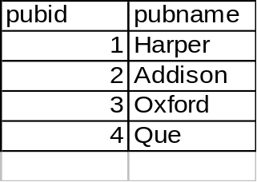
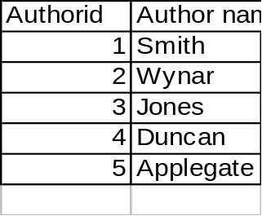
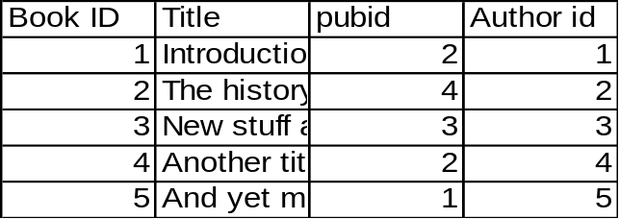
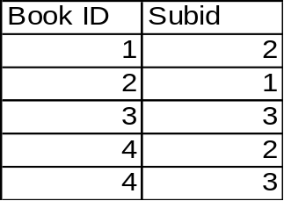
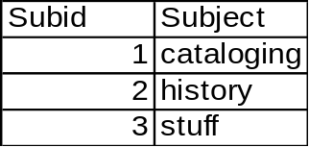
Data Models(2): History
Relational Model (1980’s)
  Provides a conceptually simple model for data as relations (typically considered “tables”) with all data visible.
Database-Introduction-1

Slide 19
Data Models(2): History
Object Oriented Data Model (1990’s)
  Encapsulates data and operations as “Objects”
Books
(id, title)
Authors
(first, last)
Publisher
Subjects
Database-Introduction-1

Slide 20
Data Models(2): History
Object-Relational Model (1990’s)
  Combines the well-known properties of the Relational Model with such OO features as:
    User-defined datatypes
    User-defined functions
    Inheritance and sub-classing
Database-Introduction-1

Slide 21
Differences between Data Models
Key Concepts
Data Definition – Structure of Database
Data Manipulation
retrieve, store, modify, delete, insert and update data in database
Data integrity
accuracy and consistency of data
Research Work !!!
Find out the differences between following Data Models based on above 03 concepts
Hierarchical / Network /Relational /Object Oriented Data Model
Database-Introduction-1

